Slide 1

PeopleFirst
Student Mental Health

Slide 2
Content
1
Meet the Team
3-4
7
Risks
12-14
2
The Problem
5-6
8
Monetization
15
3
Our Pitch
7
9
Changes
16
4
The Solution
8-9
10
Tech Stack
17
5
Product Capabilities
10
6
Our Competition
11

Slide 3




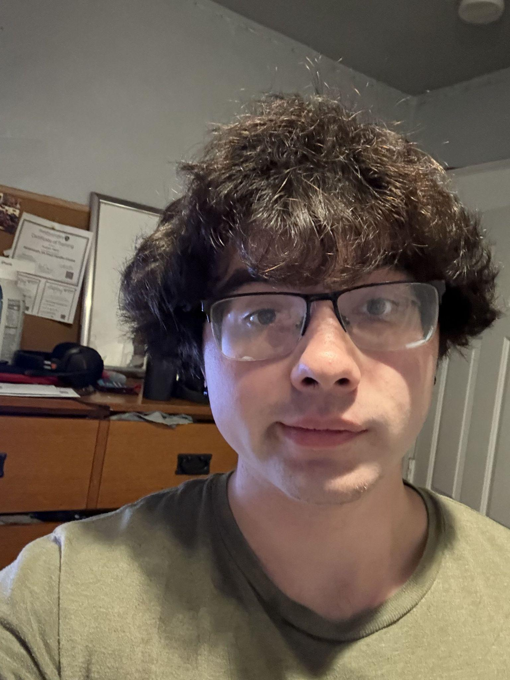

Meet the team
Quamez Anderson
Bryson Coons
Alaya Mateo
Team Member
Team Member
Team Member
Isaiah Hara
David Kabengela
Team Member
Team Member

Slide 4
Quamez Anderson
Bryson Coons
Alaya Mateo
David Kabengela
Isaiah Hara
Team Member
Team Member
Team Member
Team Member
Team Member
Full-stack software engineer with 5+ years of experience in Web Development, as well as supplementary experience with database management and game development.
I’m a senior majoring in Computer Science with a strong interest in data! I enjoy working with data and plan to pursue a career as either a data scientist or data engineer.
Computer Science major in his senior year with extensive knowledge in back-end programming in Python, Java, and C++, as well as experience with database structures.
I am a senior Computer Science major with programming skills in C++, MATLAB, and Java. I have advanced knowledge in digital image processing.
I am a Computer Science major with programming skills in C++ and Java, as well of knowledge in database structures.

Slide 5

College students struggle with mental health issues from various sources which impact their studies negatively
The Problem

Slide 6
Without PeopleFirst
1
2
3
4
5
Identify a problem
Desire for Help
Help Availability
Mediating the problem
Follow-up
Shawn struggles with the passing of his grandfather and can’t concentrate on any of his classes.
Shawn decides he wants to do something about his situation, so that he can move forward in life.
Shawn is put on a 3 week waiting list for receiving counseling because of the lack of availabilities.
Shawn speaks to his counselor, but he was matched with the first available counselor and doesn’t feel comfortable opening up.
Shawn feels uneasy about setting up further appointments because he isn’t sure if his counseling was effective.

Slide 7

We will better the college learning environment, so that many can thrive.
Our mission

Slide 8

The Solution
The creation of a free mobile app that bridges the gap between struggling college students and peer/professional assistance through online communication and helpful resources.

Slide 9
PeopleFirst’s Solution
1
2
3
4
5
Identify a problem
Desire for Help
Help Availability
Mediating the problem
Follow-up
Shawn recognizes he's struggling with grief after his grandfather's passing—he can't concentrate in class and his grades are slipping
Shawn commits to seeking help, overcoming his worries about judgment, whether his grief warrants counseling, and concerns about cost and privacy
Instead of a 3-week wait, Shawn downloads PeopleFirst and receives immediate support within minutes, available 24/7 whenever he needs it
Shawn engages at his comfort level—using anonymous peer support and mood tracking.
Shawn maintains progress through mood tracking, peer chat between sessions, and flexible scheduling. The app provides check-in reminders and personalized self-care resources
Notes:
The first step is a person becoming aware there is a problem in the first place, whether by themselves or through a friend or family member. For many students, this awareness comes through declining grades, persistent feelings of sadness or anxiety, changes in sleep patterns, or social withdrawal
This stage involves overcoming significant barriers: fear of judgment, stigma about mental health treatment, uncertainty about whether their problem is "serious enough," financial concerns, and worry about confidentiality. Students must move from "I know something is wrong" to "I'm ready to do something about it"
Resources such as therapy and counseling are, in many cases, appointment-based which can be months out from when the person is seeking assistance. Campus counseling centers are overwhelmed with wait times of 2-6 weeks or longer. When students muster the courage to seek help, being told to "wait" feels devastating. PeopleFirst eliminates this barrier through immediate, 24/7 mobile access. Students download the app and receive support within minutes—during late-night panic attacks or pre-exam stress. When students are ready for help, help is ready for them.
One of the most vital steps for healing is first impressions. Once students access PeopleFirst, ensuring they feel comfortable is critical to creating a safe space where they can talk freely. Through PeopleFirst, students engage at their own comfort level using anonymous peer-support chat, AI-powered mood tracking, and community groups with peers facing similar challenges. When ready for professional help, students browse counselor profiles and select someone who feels right. The app transforms an intimidating first step into an empowering start to healing.
The initial appointment may or may not encourage a person to seek further help depending on the interactions made. Through PeopleFirst, students maintain ongoing engagement with daily mood tracking, between-session access to peer chat and community groups, and flexible scheduling for counseling. The app sends gentle check-in reminders and provides personalized self-care resources, ensuring consistent support that keeps students engaged in their mental health.

Slide 10
Features
Feature | Student | Counselor | Admin | Notes
Forums
Create Forum topics | X | X | X
Post in open Forums | X | X | X
Flag negative comments | X | X | X
Data Privacy
Student Profile Access | X |  | X | Admins have limited access
Anonymity | X
Resources
Access | X | X | X
Add Resources |  | X | X | Counselors can request resources added
Echo
Chatbot Access | X | X | X
Rating |  | X

Slide 11



Competition Matrix
 | PeopleFirst | RecWell | BetterHelp | Jed Foundation | Student Health Services
Forums | X
Resources Provided | X | X | X | X | X
Chat Bot | X
Activities/ Events |  | X |  |  | X
24/7 Help | X |  | X | X | X
Free to Users | X | X |  |  | X
 | PeopleFirst | RecWell | BetterHelp | Jed Foundation | Student Health Services
Forums | X
Resources Provided | X | X | X | X | X
Chat Bot | X
Activities/ Events |  | X |  |  | X
24/7 Help | X |  | X | X | X
Free to Users | X | X |  |  | X

Slide 12
Risk Matrix
Severity → Probability ↓ | 1 | 2 | 3 | 4 | 5
Very Rare |  |  |  |  | Data Privacy Resource Security
Rare
Unlikely |  |  |  |  | Liability
Medium |  |  | Bias in AI Responses |  | Regulation
Possible |  |  | Help Unavailability | De-identification
High |  |  |  | Misinformation | HIPAA Compliance

Slide 13
Risks
Data Privacy/Security
Regulation
HIPAA Compliance
De-identification
Severity: 5/5 Probability: Low
Severity: 5/5
Probability: Medium
Ensuring user data remains private and anonymous is the selling point of the app. A breach of this feature could lead to legal implications for not abiding by Terms of Service.
Student Chat forums risk students that have ill-intention and can give poor advice that is detrimental to struggling students. There are also cases in which trolls enter the chat giving negative perception to an individual's case.
Severity: 5/5
Probability: High
Severity: 4/5
Probability: Medium/High
Students and counselor conversations require confidentiality from other students and developers to comply with HIPAA
The more a student shares about the problems they’re going through on forums, the more at risk they are of being identified by someone online. Mitigation: Students names not allowed in username and they’re encouraged not to over-share.

Slide 14
Risks
(continued)
Liability
Resource Security
Severity: 5/5
Probability: Low/Medium
Severity: 5/5
Probability: Low
There is a risk of becoming liable for conversations or posts that illicit self-harm within the app
Since resources are in a database, hackers could attempt to gain access and post harmful resources for students. Mitigation: Server-managed requests
Misinformation Risk (AI + Peer Forums)
Help Unavailability
Severity: 3/5
Probability: Rare
The possibility that no mediums are available for someone that needs help is mitigated by abundance of resources.
Severity: 4/5
Probability: High
Both AI and students can easily spread incorrect advice. This is extremely likely in a mental-health context. Mitigation: Reporting of posts/replies

Slide 15




Monetization
PeopleFirst will not charge students, as adding financial pressure would undermine our mission of reducing mental stress. Instead, we offer a B2B subscription model targeting colleges and universities.
Institutions purchase an annual PeopleFirst Campus Subscription and provide the service to the students at no cost.
Our sales team will emphasize that adopting PeopleFirst allows universities to:
Demonstrate commitment to student mental health.
Strengthen recruitment by offering modern mental-wellness support.
Enhance student retention through improved well-being.
This model aligns with our core values while creating a sustainable revenue stream.

Slide 16


Monetization
(continued)
Targeted Universities: Four-year institutions
Startup Advertisement: presentation and demo
Location: Strictly Virginia
Annual Subscription Rate:
Under 5000 students: $18,000
Between 5000 and 15000 students: $30,000
Over 15000 Students: $42,000

Slide 17

Changes from Prior Design
No referral rating system
Referral system
NoSQL over MySQL
No local counselors

Slide 18
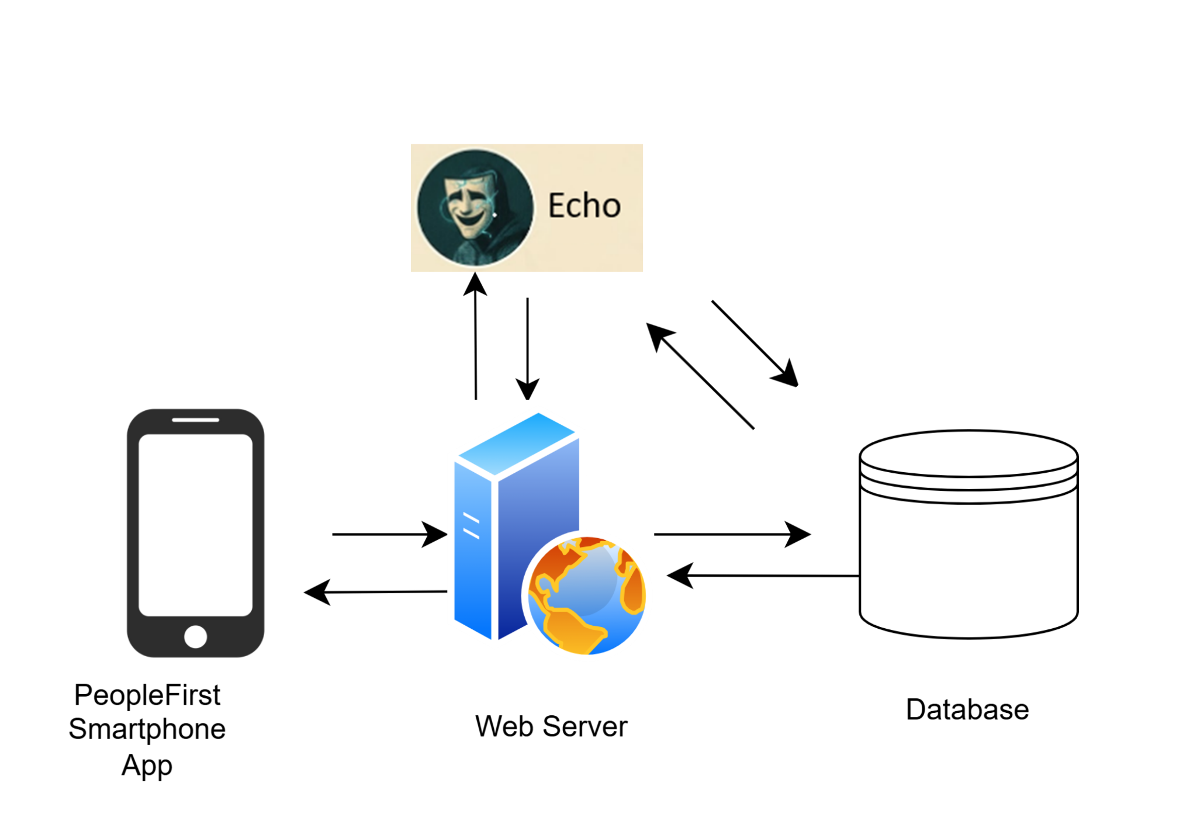
Tech Stack
Front-end - Python with Kivy graphical interface
Middle-tier - Flask developmental web server with RESTful API calls between Front-end, Database, and Echo chatbot
Back-end - Consists of NoSQL database implemented with MongoDB and a Natural Language Processing AI chatbot

Slide 19
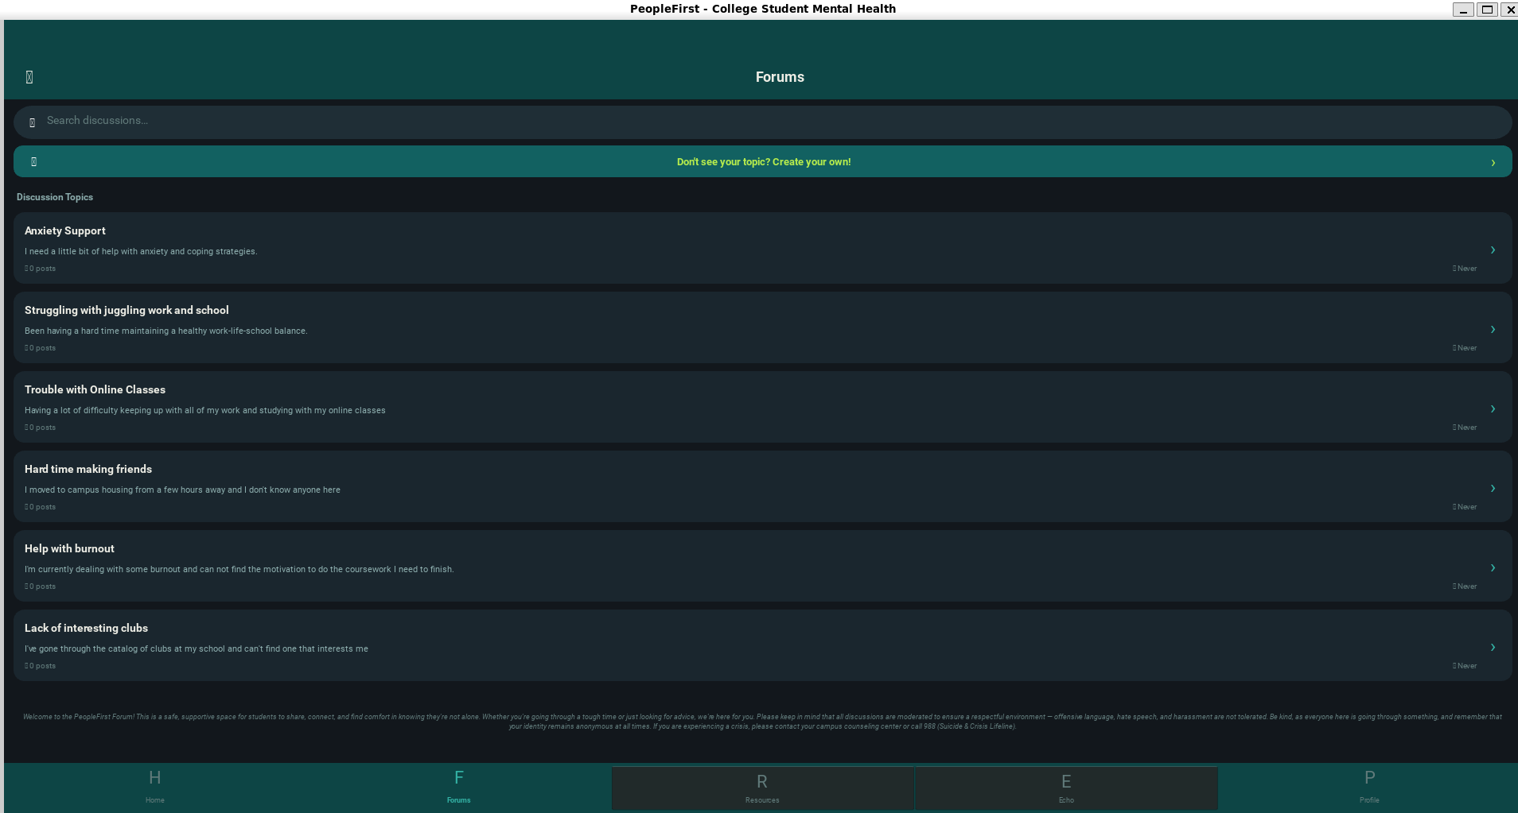
Our Forums

Slide 20
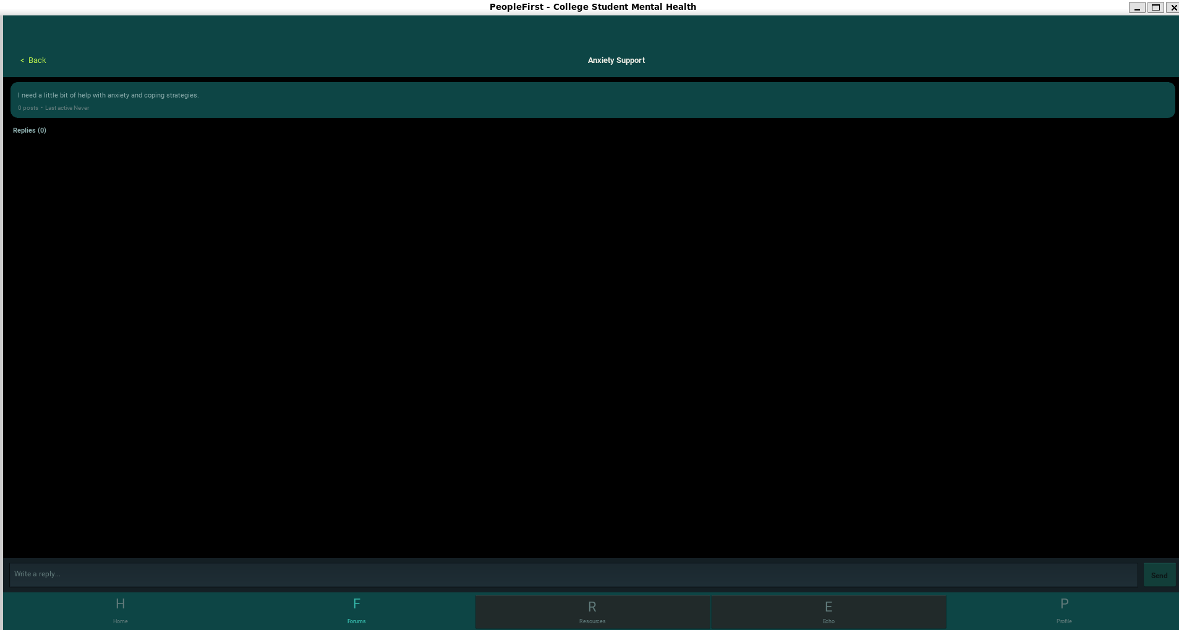
Replies to Posts

Slide 21
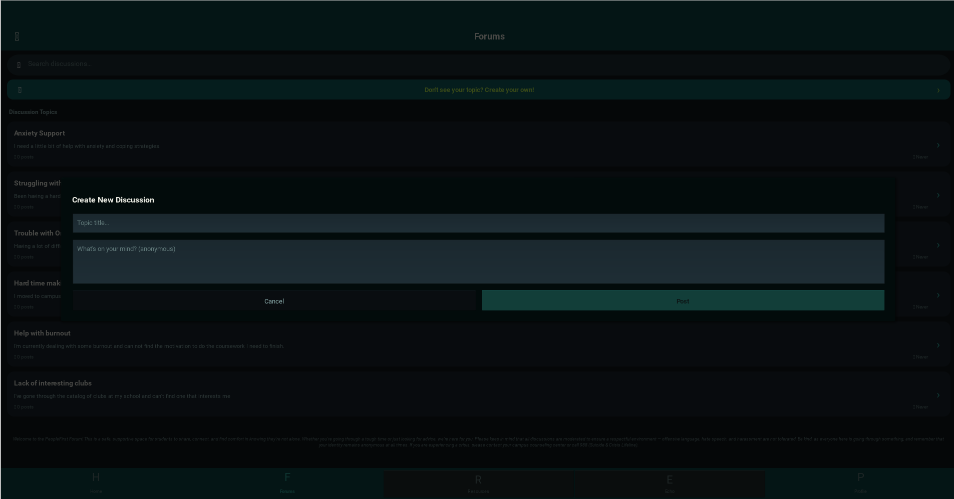
Create New Forums Topic

Slide 22
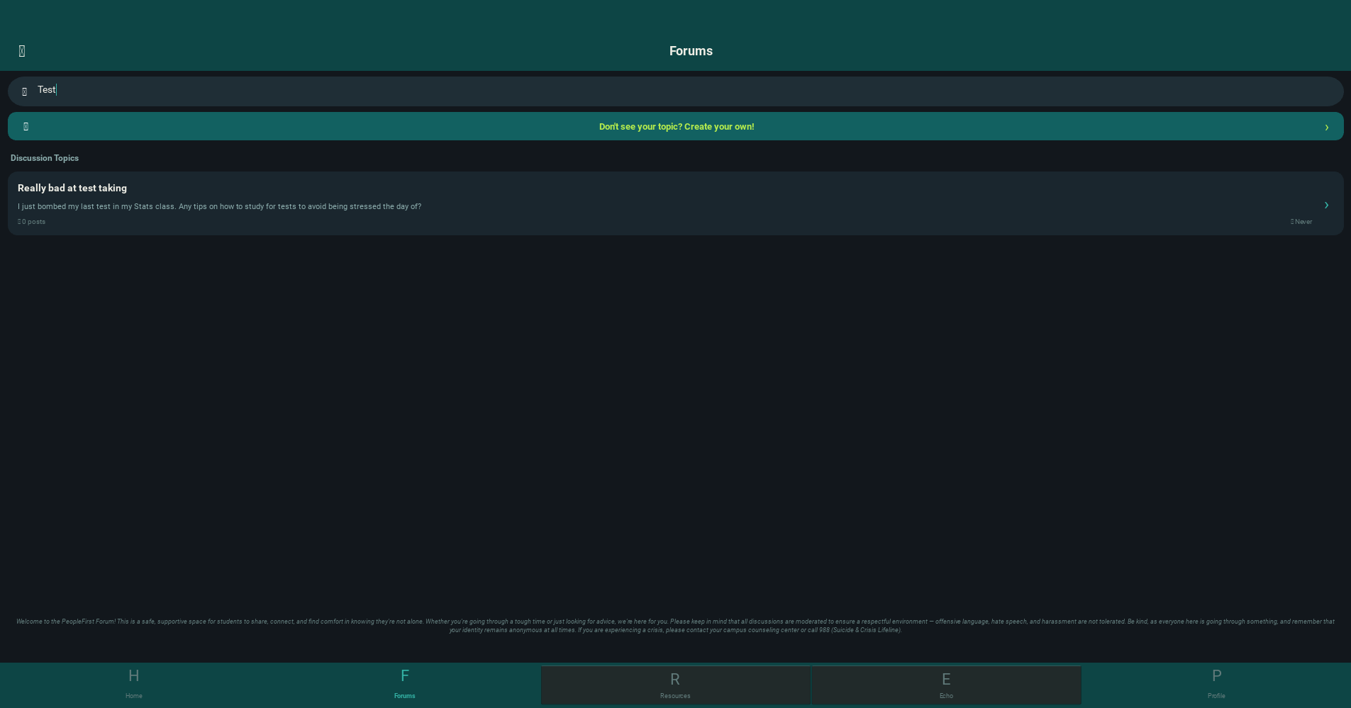
Searching the Forums

Slide 23
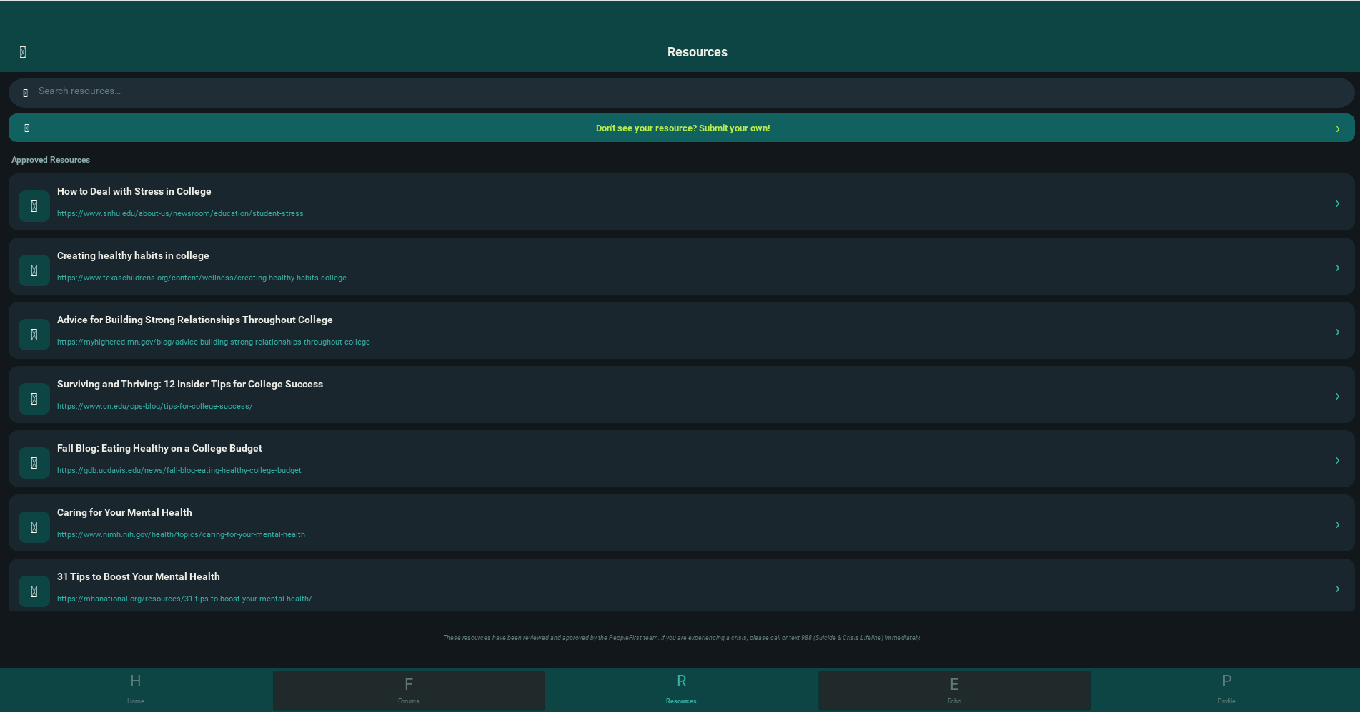
Our Help Resources

Slide 24
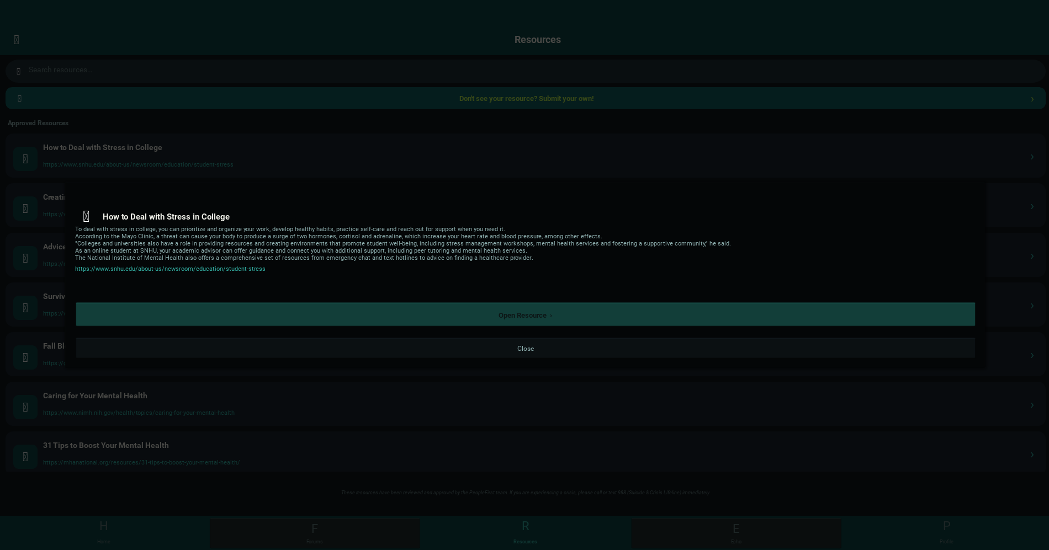
View Resource Details (including AI-generated summary)

Slide 25
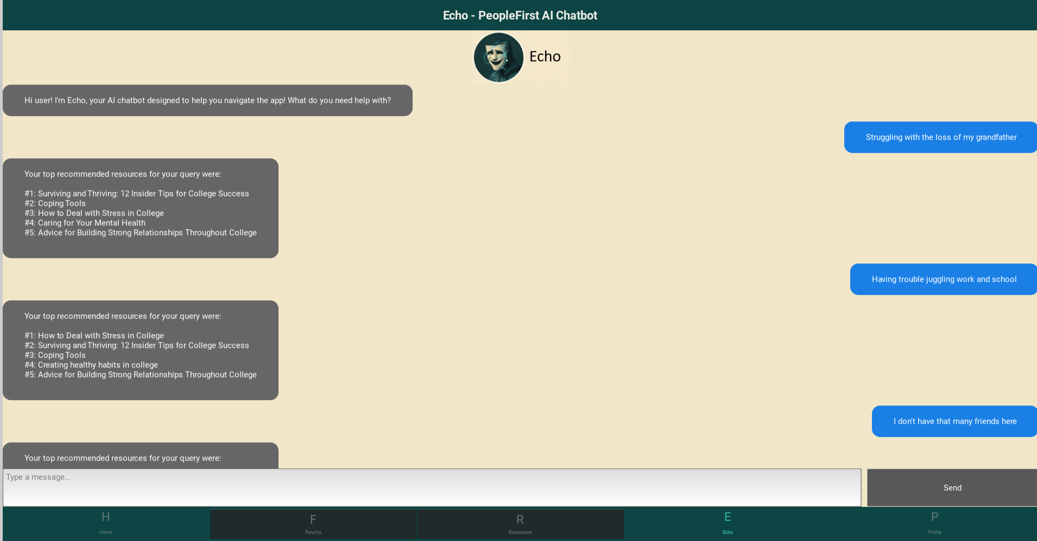
Echo Chatbot

Slide 26
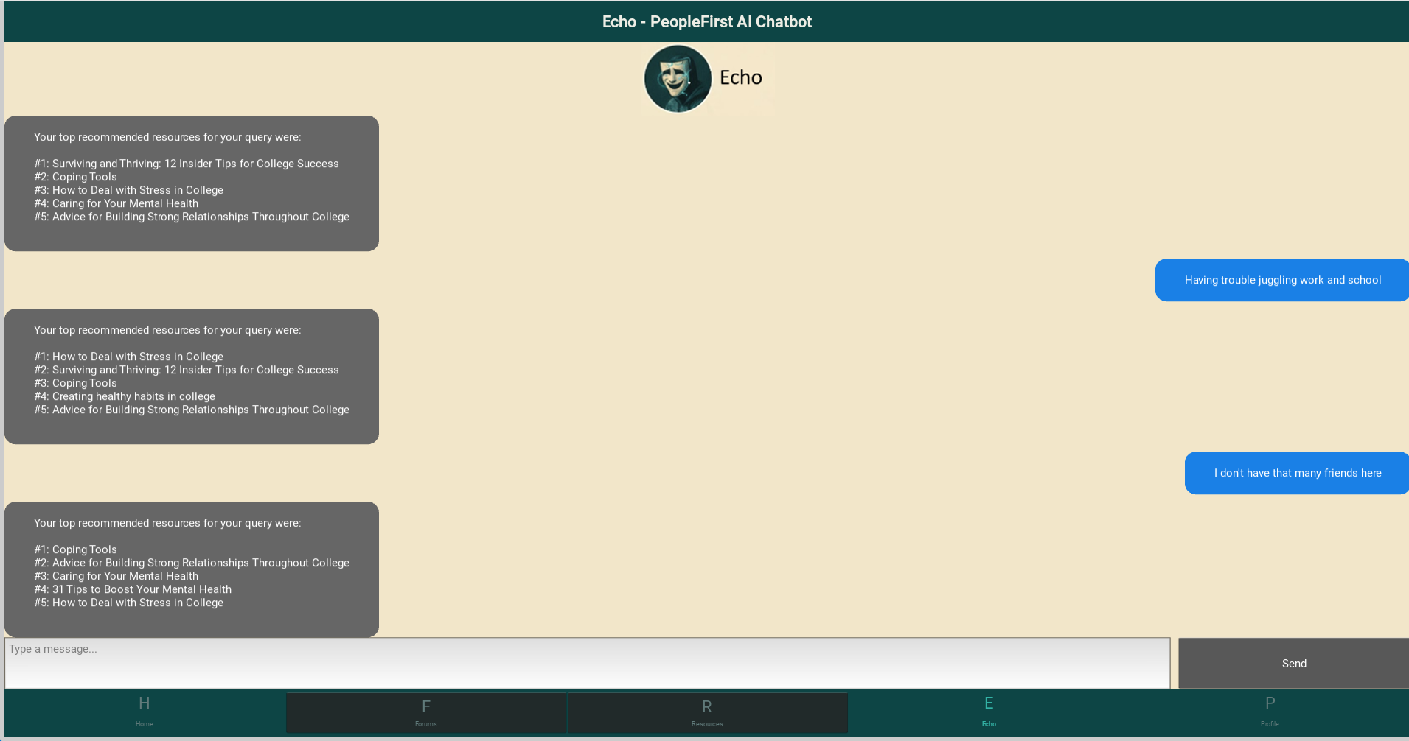
Echo Chatbot

Slide 27
References
Flannery, M. E. (2023, March 29). The Mental Health Crisis on college campuses. NEA. https://www.nea.org/nea-today/all-news-articles/mental-health-crisis-college-campuses
Professional therapy with a licensed therapist. BetterHelp. (n.d.).
https://www.betterhelp.com/
Recwell app. Old Dominion University. (2024, February 6). https://www.odu.edu/recreation-wellness/about/recwell-app
Student Health Services. https://www.odu.edu/studenthealth. (2025, September 10). https://www.odu.edu/studenthealth
The Jed Foundation. (2025, October 17). https://jedfoundation.org/

